Slide 1



Chowgacha - Jhenaidah Model: A New Dinention of Health Service Development.
Dr. Md.Emdadul Haque
Senior Nation Consultant C -J model replication committee

Slide 2
Background History of C-J Model
The program starts in Chowgacha UHC in 1986.
Social mobilization program starts in Lohagara UHC , Narail from 1989 - 1995
In 1995-97 open 4 section a) ANC corner,b) Under-5 corner c)birth&death record ing unit.d) Health education corner
In june 2008 ,MOH&FW decleared the Chowgacha UHC as Model UHC of Bangladesh.
In 2010 D G of WHO recommended to replicate it.
Jhenaidah Sadar Hospital Model starts in 2012
C-J Model replicate in 2015 by MOHFW in 11 district hospital& 5 Upazilla UHC.Now replicating by the order of PM office,ADG(Admin)is ChairPerson.

Slide 3
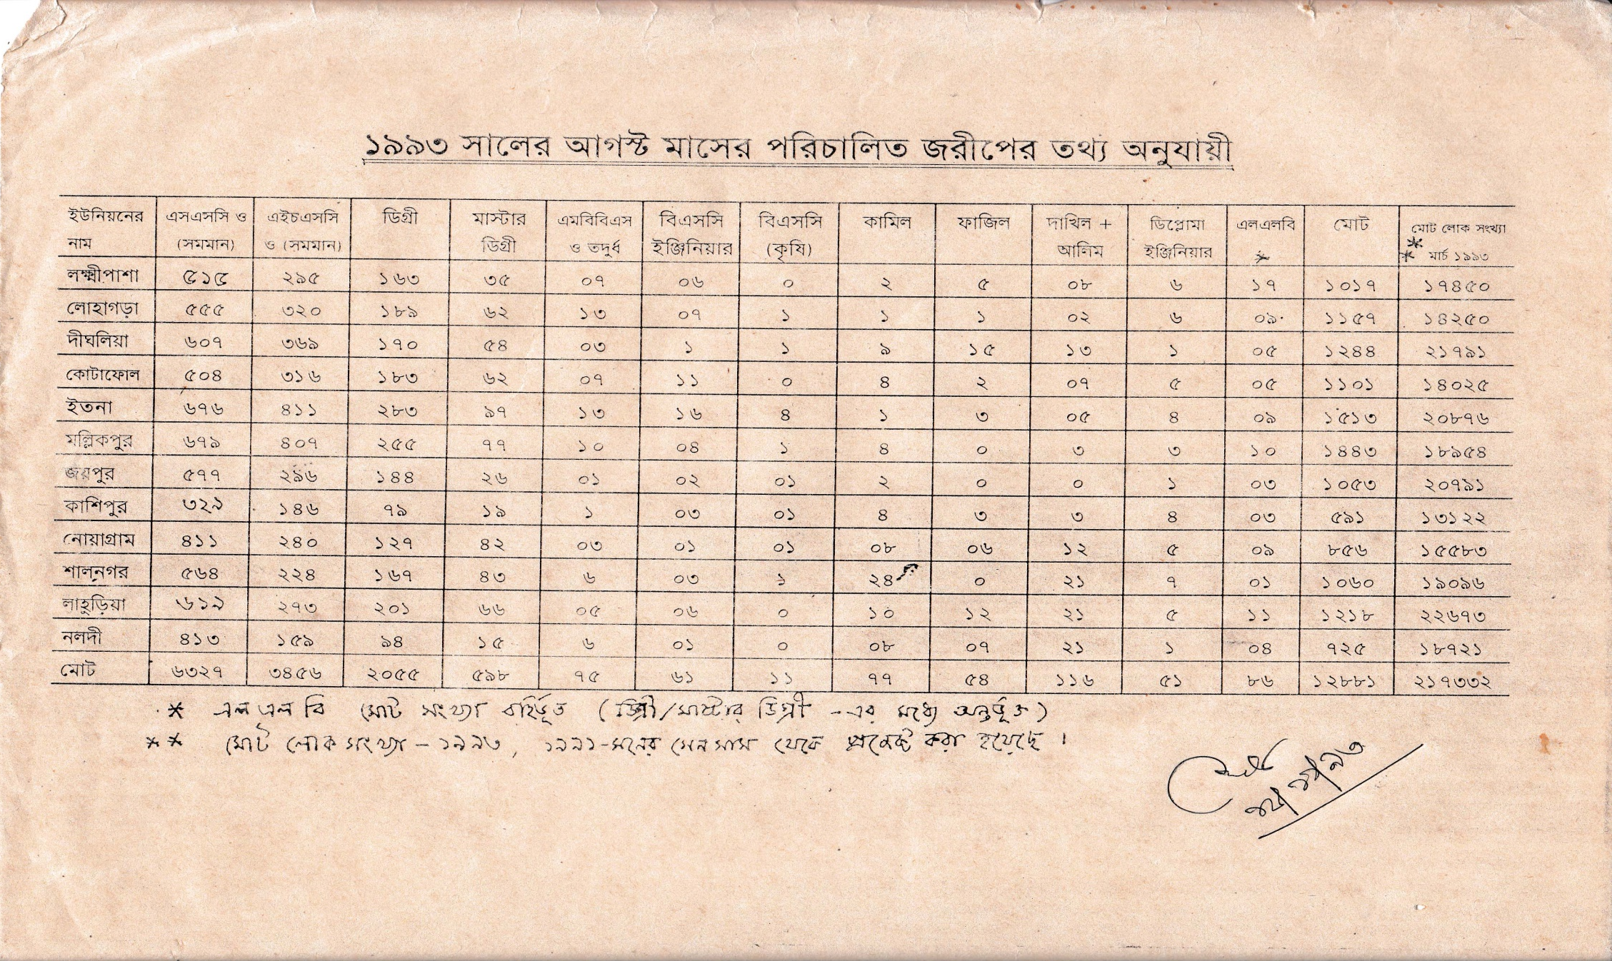
নড়াইলের লোহাগড়া উপজেলায় ইউনিয়নওয়ারী জরীপে জনসম্পদের তথ্য

Slide 4




Community Mobilization Meeting at Lohagara in 1995

Slide 5



CHOWGACHA UPAZILA HEALTH COMPLEX
Chowgacha, Jessore.
Previous UHC
Present UHC

Slide 6
Comparative data of health facilities of different country of the world
SL NO | Country | Per capita health Expenditure per year by Govt. ($) | Doctors per 10000 Population | Nurse per 10000 Population | Beds per 10000 population | Out of pocket expenditure %
01 | USA | 9536 | 25.5 | 99 | 37 | 11.08
02 | UK | 4356 | 28.0 | 84 | 30 | 14.79
03 | Malaysia | 386 | 12.8 | 34 | 18 | 36.67
04 | Sri Lanka | 118 | 7.3 | 17.5 | 31 | 38.43
05 | India | 63 | 7.3 | 20.4 | 09 | 65.06
06 | Nepal | 44 | 08 | 4.7 | - | 60.41
07 | Pakistan | 38 | 08 | 06 | 06 | 66.40
08 | Bangladesh | 37 | 3.9 | 03 | 03 | 67.00
From internet 2018

Slide 7
A Sub-district level Hospital with a Vision …
Maximum utilization of Govt.
resources with
honesty and sincerity.
Integrated approach of
Administration, Community
Leaders .
Providing Effective services
through improved
management system.

Slide 8


Blood donation program stared in 16 December, 1996 in Chowgacha UHC
A seminar held on basic information system at Chowgacha Degree College in June, 1997. DC Jessore was the chief guest .

Slide 9


Community supported volunteer working in ANC corner
Community Supported Volunteer Working as receptionist.

Slide 10
Achievement of Chowgacha Health Complex
In 2008, Chowgacha Health Complex declared as the model upazilla health complex.
  All the components of primary health care implemented in Chowgacha in 2000.
  Chowgacha UHC became the best EOC center with 98.4% (4413)delivery rate
  Chowgacha UHC achieved MDG target in 2009
  .
  Chowgacha Health complex is awarded for best performance in EOC form 2004 to 2014& 2017.

Slide 11

Upazila Health Complex
CHOWGACHA , JESSORE.
EOC Activities : 1997- 2011 (Hospital Delivery )

Slide 12
Upazilla Health Complex
CHOWGACHA , JESSORE.
COMMUNITY SUPPORTED MANPOWER
TOTAL :46
  Volunteers :26
  Cleaners & guards :16
  Others :04
  The remunerations come from
  Outsourcing :25
  Service provider :21
  The amount of remuneration ranging from 200/= To 8000/=tk. Per month depending upon the style of work, which costs a total of nearly 90,ooo/=Tk per month.

Slide 13
Chowgacha Health Complex – improvement evaluation (1995-2017)
Subject | 1995 | 1996 | 2000 | 2007 | 2011 | 2017
Bed Occupancy Rate % | - | - | 93.5 | 201 | 208 | 171
ANC (First Visit) | - | 16.3 (817) | 59 (2861) | 132 (7292) | 170 (8935) | 130 (6632)
Hospital Delivery Rate % | - | 2.1 (99) | 6.4 (422) | 38.1 (1899) | 98.4 (4413) | 66 (2932)
C-Section rate % | - | .02 (1) | 0.07 (3) | 9.6 (473) | 22.5 (1107) | 17
MMR/100,000 live birth | 599 | 300 | 168 | 160 | 68 | 91
NMR/ 1000 live birth | 42 | 47 | 23 | 21.5 | 18.2 | 16.6
IMR/ 1000 live birth | 65 | 58 | 36 | 29.2 | 23.6 | 18.6
U5MR/ 1000 live birth | 78 | 67 | 44 | 33.3 | 25.7 | 21.1

Slide 14



Slide 15


Slide 16

100 kh¨v wewkó m`i nvmcvZvj, wSbvB`n

Slide 17
Challenges of the hospital in 2012
In secured hospital environment.
Performance of all activities was very low.
Very limited support staff.
Receiving money from the patients by non-govt. staff.
Waste management system was poor.
Monitoring meeting was not performed regularly

Slide 18

Sadar Hospital, Jhenaidah
Bed Occupancy Rate from 1998 to 2018

Slide 19
Emergency & Out Door, Indoor Service 1998 to 2018
Sadar Hospital, Jhenaidah

Slide 20
3 best performing EmOC Hospital in Khulna division - 2018
Sadar Hospital, Jhenaidah

Slide 21
Comparative data of revenue income (in Taka) from 2015 to 2018
Sadar Hospital, Jhenaidah

Slide 22
Community Support System in Sadar Hospital
56 manpower (Cleaner 21, Ayah & ward boy 22, Guard 7, Volunteer 3, Trolley man 3 ) is supported by the community.
MP of Jhenaidah-2 supports 14, Zahedee foundation 12 , Mayor of Jhenaidah Paurasava 5, doctors of Jhenaidah support 17 manpower.
Mayor of Jhenaidah Paurasava plays an important role in security , cleanliness, renovation of pediatric word and arrange a mayoral conference.
Retired secretary donated a generator, Zahedee foundation donated an inter-com, mayor donated a biochemistry analyzer.

Slide 23




KAIZEN in Jhenaidah Sadar Hospital

Slide 24




KAIZEN in Jhenaidah Sadar Hospital
Before
After
Before
After

Slide 25







KAIZEN in Jhenaidah Sadar Hospital
Before
After

Slide 26




Local Govt. (Paurashava) Participation
Before
After
Before
After

Slide 27




KAIZEN in Jhenaidah Sadar Hospital
Color code
Color code
Use of direction sign
waist segregation

Slide 28




KAIZEN in Jhenaidah Sadar Hospital
Reception room
Creation of nursing aid
Health education session
Community engagement

Slide 29


KAIZEN in Jhenaidah Sadar Hospital
Recovered Valuable land after sixty years.
Arranged get man to control crowed in ward by Community support

Slide 30




Improved pediatric word by local initiative

Slide 31




Hospital Environment

Slide 32
Achievements of Jhenaidah Sadar
Hospital
1. Active Community Participation is an example in Bangladesh.
2. Improved performance of all services.
3. Improved Cleanliness and Beautification of Campus.
4. Functioning of X-Ray service and Biochemistry investigation
5. Improved Security
6. Improved Financial Management
7. “Model ” is replicating in 11 district and 5 upazilla hospital
8. The hospital is awarded 7 times from 2013 to 2018.

Slide 33
Need to implement health related SDG
by 2030
01 M.A in every community clinic
10 bedded hospital with 2 doctors, 6 nurses and paramedics in every union.
100 bedded hospital In every upazilla
500 bedded hospital in every district.

Slide 34

Thank You
Notes:
34

